Slide 1
Special guardians and kinship care – impact of COVID-19 and next steps for supporting families
London Adoption & Permanency Board
Kate O’Brien – Director of Business Development & Programmes
Kelly McDonagh – Senior Programmes Manager
November 2020

Slide 2
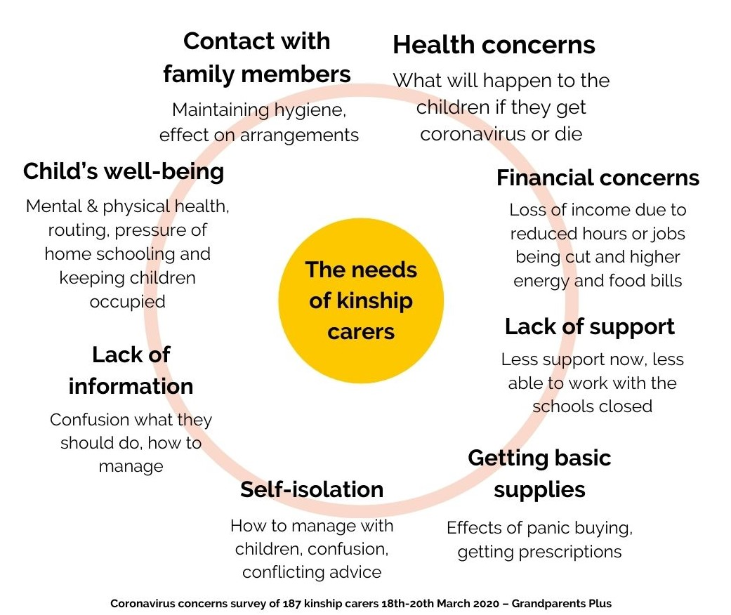
Carers’ needs: COVID-19 surveys

Slide 3
London-specific: COVID-19 surveys
Children at home all the time when schools closed mixed feelings – pros & cons
Financial difficulties - concerns increased as time went on
Scarcity of essential items - making sure they could get enough food, etc.
Sufficient space e.g. one respondent is living in a hotel
Feeling isolated, tearful, stressed - almost every respondent had been emotionally impacted.
Impact on the child/children:
Boredom
A distinct deterioration in behaviour, including mood swings, running away or becoming isolated from the rest of the family.
Most described the easing of restrictions as confusing and they felt anxious.
Source: Coronavirus concerns surveys Mar, May & June 2020 – Grandparents Plus
Notes:
The distinction between social action and volunteering is an important one. All volunteering is social action but not all social action is volunteering.

Slide 4
State of the Nation survey: London
COVID
80% of kinship carers responding in London were special guardians (66% - the child was previously looked after in local authority care)
64% said it was difficult or very difficult to manage
52% said it was difficult or very difficult for the children in their care
27% said they would struggle to cope if there are further restrictions
Source: State of the Nation survey (to be published Oct 2020) – Grandparents Plus

Slide 5
“It’s been an emotional rollercoaster…” (special guardian in London, May 2020)
Source: Coronavirus concerns surveys Mar, May & June 2020 – Grandparents Plus
Notes:
The distinction between social action and volunteering is an important one. All volunteering is social action but not all social action is volunteering.

Slide 6
Kinship Response
COVID-19-specific funding - funded by the Department for Education via the Adoption Support Fund – positive changes – transformation of support
Developed COVID-19 service to support special guardians
68 local authority members spread across the country (England only)
24 London boroughs – responded quickly
Target to support 904 special guardians with 1:1 support
Notes:
The distinction between social action and volunteering is an important one. All volunteering is social action but not all social action is volunteering.

Slide 7
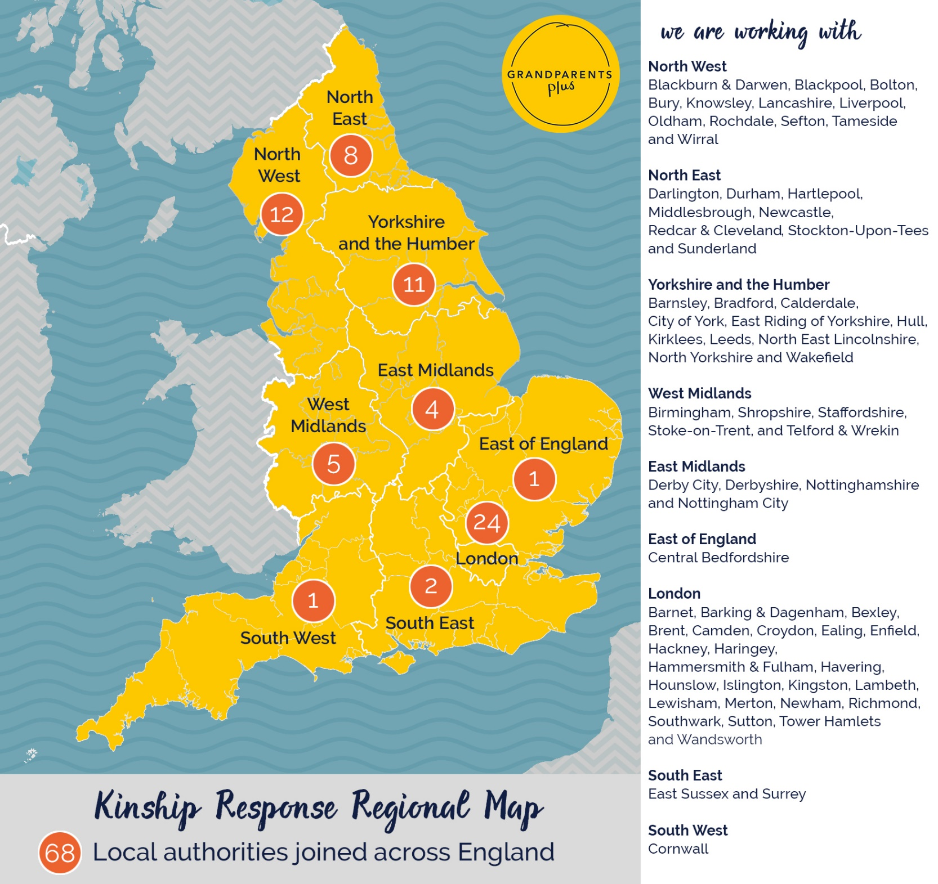
Notes:
The distinction between social action and volunteering is an important one. All volunteering is social action but not all social action is volunteering.

Slide 8
Reach of services in London
232 attendees at 41 virtual support groups in London since April 2020 (average 5/6 per group)
138 special guardians supported 1:1 via Kinship Response Tier 2
338 supported via advice service in London since April & 50 received grants worth £27,026
56 matched with a Someone Like me Volunteer
Kinship Ready – preparatory workshops for special guardians – run four workshops online in East London since lockdown

Slide 9
Key themes from 1:1 support
Relentless nature of parenting children who have suffered trauma at the same time as experiencing a significant reduction in available support.
Transition back to school – some carers finding it harder than when children were at home.
Increase in requests for advice and support regarding child on carer violence. The advice many carers are getting from local authorities appears to be a standard ‘call the police’ response. They find this unhelpful.
Increased carer anxiety from BAME community – especially in light of media reports that BAME community are twice as likely to die from coronavirus.
Source: Case reviews with London project workers Mar to Sept 2020 – Grandparents Plus

Slide 10
Kinship Response: London case studies
Current Circumstances
Local authority referral, 3 SGO children (17, 16 & 14) and 3 biological children in care of second cousin and his wife
Recent bereavement issues and issues around contact with birth mother
Financial concerns: job loss within family unit due to COVID. No money for school uniform/ replace broken bunkbed/ children’s activities, including music and boxing classes
Actions
Making contact with the family was a challenge for the project worker - 4 attempts to make contact by phone, email and text.
Discussions with the carers and information provided re contact. Carer now also feeling supported by social worker
Grant submitted - total amount requested £600
Information provided regarding NATP
Project worker will also refer to Someone Like Me and virtual support group
Notes:
The distinction between social action and volunteering is an important one. All volunteering is social action but not all social action is volunteering.

Slide 11
Kinship Response: London case studies
Current circumstances
Self- referral
Provided very limited information regarding current circumstances: “Have behaviour problems with 2 of the children - also problems around contact and money.”
Actions
Provided information on managing contact for both birth parents and special guardian. Provided information sheets.
Discussed online home-schooling resources and appropriate links shared
Explored resources including: The Adopter Hub, NATP, Adoption Plus
Project worker to research local food voucher resource
Mindfulness podcast shared
Referral to virtual support group
Internal referral to advice service
Notes:
The distinction between social action and volunteering is an important one. All volunteering is social action but not all social action is volunteering.

Slide 12
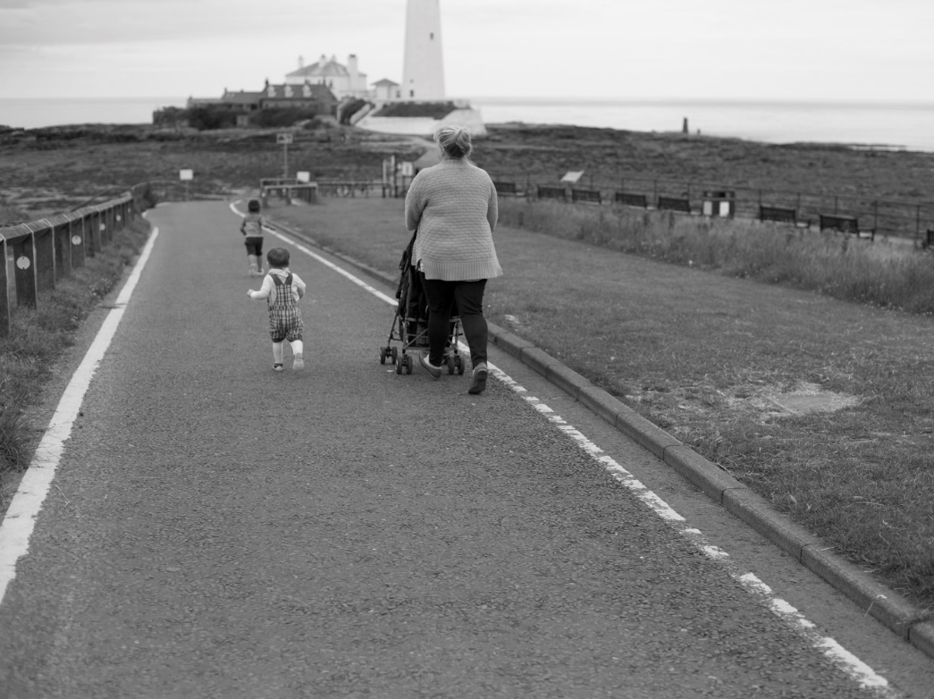
“I can’t believe how helpful you are . We have had no support so this help has really touched us . We can really see some light now .I wish I knew about this service a year ago.”
“Thank you for your email. I have just finished making the self referral to PAC-UK and I will read through some of the other links tonight once the children are in bed!”
“Once again thank you for your time on the phone and letting me ramble on!”
Notes:
Grandparents plus/ local authority combine.
Take questions. Ask for one thing that you'll take away with you today… give out evaluation forms
Give out kinship Care Guide. Follow to call to see how the training has impacted.

Slide 13
Learning: benefits of collaboration with local authorities
Collaboration with Adopt London regarding service design for Kinship Response
Local authority teams sharing information with Grandparents Plus to disseminate to carers
Adopt London invested in additional specific support – e.g. PAC-UK, NATP, Adoption Plus – somewhere to refer to
Promotion of Kinship Response by local authority teams (team meetings) to special guardians across London – reflection of need
Kinship Connected – swift move to virtual support groups & Kinship Ready – moved quickly to virtual delivery
Notes:
The distinction between social action and volunteering is an important one. All volunteering is social action but not all social action is volunteering.

Slide 14
“I absolutely loved it!! It is amazing to contact with people and to hear their stories and their experiences. Also I received very valuable information. Thank you!!” (special guardian participating in Kinship Ready workshop, East London Sept 2020)
Notes:
11.40 – 11.50 FROM HERE TO SLIDE with feedback (15.00) and quzz answer time Until slide 19
Can read support information from handout from first slide presentation (JUNE) answer questions.

Slide 15
Beyond COVID-19: continue to support special guardians
Grandparents Plus State of the Nation survey
48% said they didn’t get the advice & information they needed from the local authority when the child first move in
52% said they didn’t get the support they needed from the local authority when the child first moved in
34% said they’re getting the financial support they need from the local authority
16% said they were getting enough support from the local authority
20% said they were getting the advice
Source: State of the Nation survey (Oct 2020) – Grandparents Plus

Slide 16
Beyond COVID-19: improving support for special guardians
Focus on preparation – Public Law Working Group recommendations: https://www.grandparentsplus.org.uk/news/grandparents-plus-responds-to-the-public-law-working-group-special-guardianship-order-recommendations/
Parliamentary Taskforce on Kinship Care recommendations: https://www.grandparentsplus.org.uk/news/parliamentary-taskforce-report-of-kinship-care/
Increased focus on support for special guardians – role in reducing number of children coming into care. At risk group.
ASGLB Special guardian support guide (due for publication soon)
Evaluation of Kinship Connected – benefits of one-to-one and peer support with 20% ROI: https://www.grandparentsplus.org.uk/news/kinship-connected-evaluation/
Economic case for investment in kinship care by Nicol Economics: https://www.grandparentsplus.org.uk/news/the-economic-case-for-kinship-care/
Notes:
The distinction between social action and volunteering is an important one. All volunteering is social action but not all social action is volunteering.

Slide 17
Questions?
Kate O’Brien – Director of Business Development & Programmes
Kate.Obrien@grandparentsplus.org.uk
07968 149915
Kelly McDonagh
Senior Programmes Manager – South
Kelly.McDonagh@grandparentsplus.org.uk
07984 183052

