Slide 1
London Strategic Managers and Parent Carer Network
25th November 2020

Slide 2
AGENDA
Wellbeing Matters
9.00 – 9.05 | Welcome and introductions
9.05 – 9.35 | Autism and Intellectual Disabilities Intensive Intervention Team (AID-IIT) Catherine Sholl-Consultant Clinical Psychologist South London and Maudsley NHS Foundation Trust
9.35 – 10.00 | Wellbeing for Education Stephie Withers – Group Lead SEN Advisory Teams, LB Bromley
10.00 -10.20 | Health Update Alison Markwell – Head of SEND Health Partnerships / Senior Designated Clinical Officer for SEND, LB Hammersmith and Fulham
10.20-10.30 | Break
10.30-10.45 | Wellbeing Matters Ros Luff & Fazilla Amide – NNPCF Steering Group members, London Region
10.45-11.00 | Regional SEND programme Mary Wood – SEND Regional and National Network Strand Delivering Better Outcomes Together (DBOT)
11.00-11.15 | SEND E Learning programme Fazilla Amide and Sarah Mclean – LB Enfield
11.15 | Close
Please use the Chat facility for discussion and sharing of good practice across London.

Slide 3
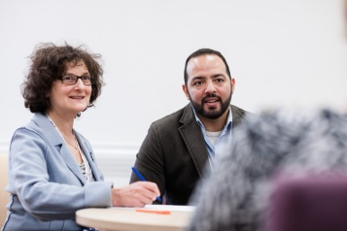
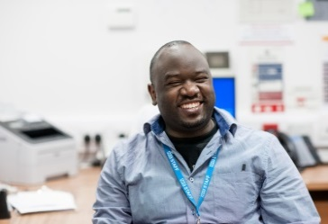
Autism & Intellectual Disabilities Intensive Intervention Team (AID-IIT)
South London and Maudsley NHS Foundation Trust (SLAM)
National & Specialist CAMHS
Dr Catherine Sholl, Consultant Clinical Psychologist
AID-IIT
Autism & Intellectual Disabilities Intensive Intervention Team

Slide 4
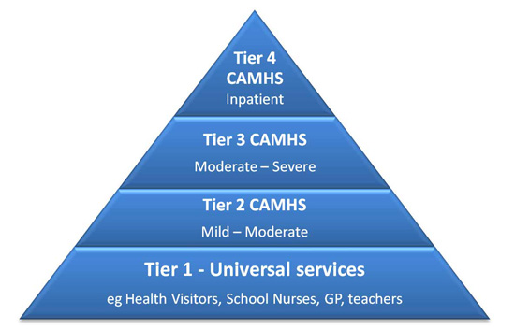
Who are AID-IIT?
Tier 4 National & Specialist Outpatient CAMHS
Cover all 32 London boroughs
Work closely with the Service for Complex Autism and Neurodevelopmental Disorders (SCAAND) in SLaM
Fully funded by NHS England in response to the Transforming Care Agenda
Our aims:
Reduce or prevent, where possible, inpatient CAMHS admissions for children and young people with Intellectual Disabilities and/or Autism
Support these young people to continue to live within the community
For young people admitted to hospital, we work closely with local and inpatient teams to make admissions as useful as possible and support their transition back into the community

Slide 5
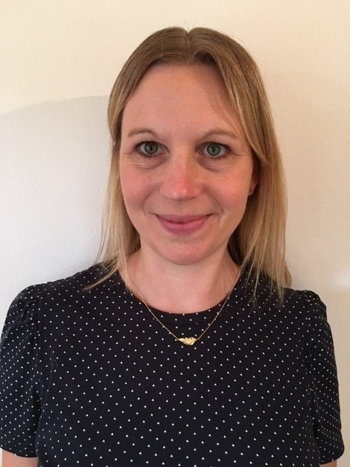
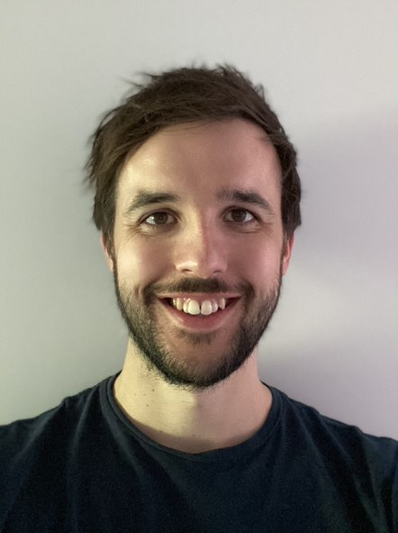
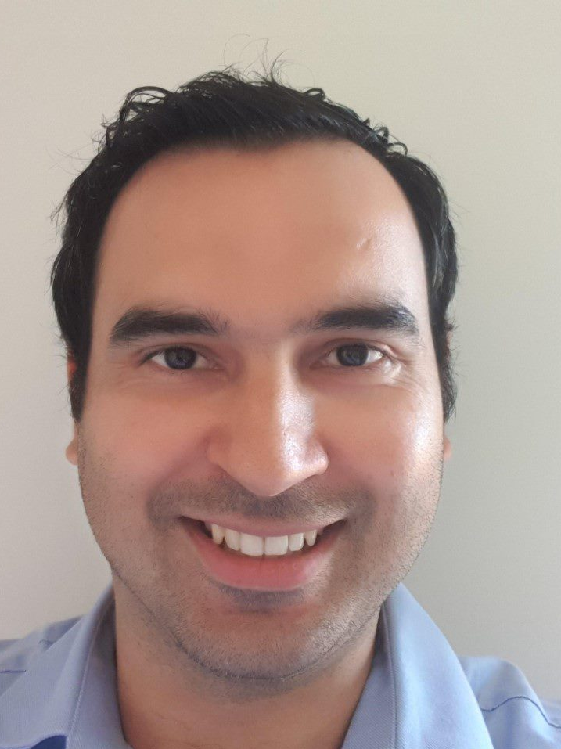
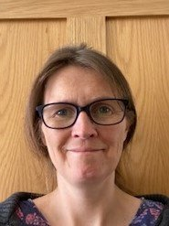
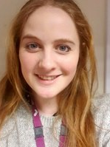
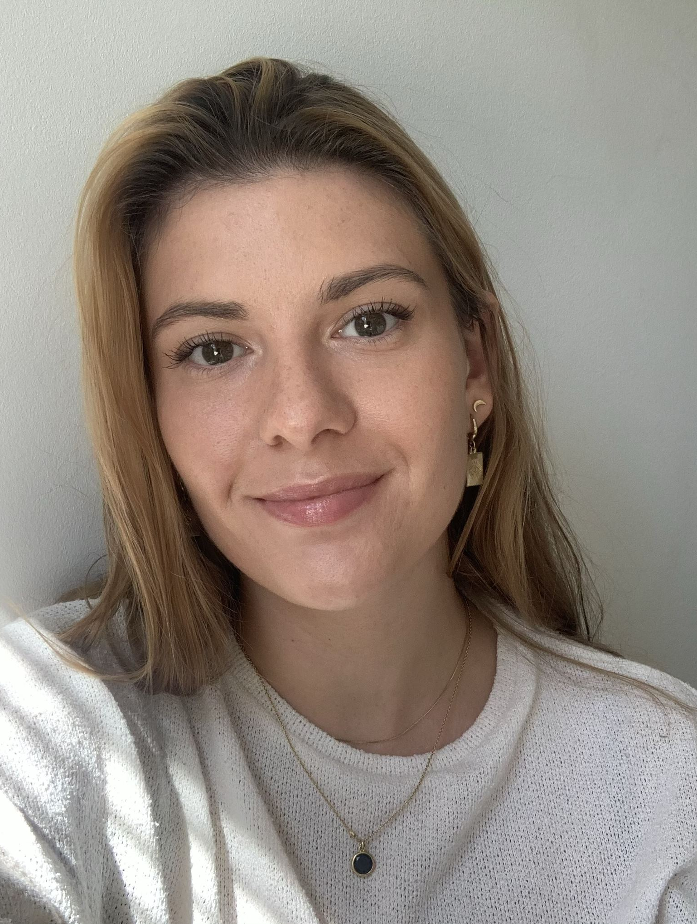
Meet the Team (so far)
Dr Catherine Sholl
Consultant Clinical Psychologist
Dr Dominic Wrein
Clinical Psychologist
Dr Georgina Barnes
Clinical Psychologist
Ranjan Kale
Project Manager
Millie Pittam
Speech & Language Therapist
Sarah Gilbert
Occupational Therapist
Maisie Krisson
Assistant Psychologist

Slide 6
Why do we need AID-IIT?
Transforming Care aimed to end over-reliance on hospital admissions or residential placements for people with ID and Autism
Nearly ten years on from the Winterbourne View investigation, still not enough progress has been made (Cooper, 2020)
Young people with ID and Autism continue to be inappropriately admitted to mental health hospitals
This is experienced by many young people and families as a negative, rather than helpful, experience (Childrens Commissioner report, 2019)

Slide 7
Where did AID-IIT come from?
Valuing People (2001) & Valuing People Now (2009)
A Strategy for Learning Disability for the 21st Century
Mansell report revised (2007)
Aiming High for Disabled Children (2007)
BBC Panorama documentaries
Winterbourne View (2011)
Whorlton Hall (2019) – Exposed abuse of people with LD in privately run, NHS funded mental health hospitals
Transforming Care Agenda (2012)
Children and young people with LD should have access to community based care and support near their family and community. Importance of joint commissioning between health and social care
NICE guidance for challenging behaviour (2015)
Importance of functional analysis and Positive Behavioural Support (PBS)
STOMP/STAMP (2016)
Too many people with ID and/or ASD are taking psychotropic medication and in cases where they do not have the condition the medication is for
Lenehan & Geraghty (2017)
High numbers of children with LD still in residential placements, highlighted that more needs to be done to prevent family homes breaking down through good multiagency local support
NHS long term plan (2019)
All areas to provide intensive support to children with LD to prevent hospital/residential care based on e.g. ‘Ealing ITSBS model’
Children’s Commissioner Report (2019)
“Far less than they deserve: children with LD or Autism living in mental health hospitals”

Slide 8
What can AID-IIT offer?
Our Multi Disciplinary Team
3 x Clinical Psychologists
1 x Assistant Psychologist
1 x Occupational Therapist
1 x Speech and Language Therapist
1 x Project Manager
1 x Consultant Psychiatrist
1 x Clinical Nurse Specialist
1 x Social worker
1 x Specialist NAS Teacher
What we offer
AID-IIT works in addition to (not instead of) local services – i.e. we joint work or ‘aid’ services working with complex young people at risk of admission
Short term additional input from AID-IIT then step down to local services
Range of activities can be offered including:
Multi-disciplinary assessment of the young person’s needs and recommendations for their future support
Multi-disciplinary interventions and support to the young person and their family (e.g. psychology, psychiatry, nursing, OT, SaLT)
Consultation, training and advice to other professionals
Attendance at CETRs, CPA, and other care planning meetings
Education advice/support from specialist teacher (Jan 2021)
Outreach work into the family home, hospital setting, school, etc if clinically needed

Slide 9
What is our referral process?
Referral criteria:
Any CAMHS professional can refer. Young person must meet all the following criteria:
Under the age of 18 (and not very close to 18th birthday)
Have a diagnosis of Autism or Intellectual/Learning disability
Have their home address in a London borough
Be open to a London borough CAMHS
Be either:
At risk of admission to an inpatient unit OR
Already admitted to an inpatient unit OR
Recently discharged from an inpatient unit
Remain open to a local CAMHS team who are willing to engage in joint meetings and clinical work with AID-IIT when needed and to step care back to once AID-IIT have completed work
Consent for referral must be obtained from the family and where possible the young person
How to refer:
Email referral to aidiit@slam.nhs.uk and somebody will contact you within 24 hours to discuss
If referral is agreed, then they will email you a referral form to complete
When can we refer:
Aim to be operational from October 2020 and service fully staffed and developed by end March 2021
Have started with a small caseload already (agreed on a case-by-case basis)

Slide 10
Examples of when to refer to AID-IIT
Example 1 - Young people in the community:
Young person has diagnosis of LD or ASD
Presenting with significant challenging behaviour or mental health difficulties that may require a future residential placement or inpatient admission
Other appropriate interventions are in place (e.g. social care, respite, local CAMHS) and difficulties continue to escalate
On dynamic support register/CETR being planned
Example 2 - Young people in hospital:
Young person with LD or ASD is in hospital and has a complex presentation that team need help understanding, and/or need consultation/support with care and discharge planning
Example 3 - Young people recently discharged from hospital:
Young person with LD or ASD recently discharged from hospital and need support to prevent re-admission or placement breakdown

Slide 11
How to contact us
Team Lead: Dr Catherine Sholl
Consultant Clinical Psychologist
Address: South London and Maudsley NHS Foundation Trust
Autism and Intellectual Disabilities Intensive Intervention Team (AID-IIT)
Service for Complex Autism and Associated Neurodevelopmental Disorders (SCAAND)
Michael Rutter Centre for Children and Young People
Maudsley Hospital
De Crespigny Park
London
SE5 8AZ
Website: https://www.slam.nhs.uk/national-services/child-and-adolescent-services/scaand
Email: Catherine.sholl@slam.nhs.uk
aidiit@slam.nhs.uk

Slide 12
Supporting Emotional Wellbeing and Mental Health in Bromley
www.bromley.gov.uk/localoffer

Slide 13
Back to the start ….
A strong drive to support children, families and schools
Overwhelming amounts of information – a focus on categorisation and making accessible
Wellbeing checks
Single point of contact for all Bromley schools through the SEN Advisory Teams

Slide 14
A Joined Up Approach To Support ….
Why was this important ….
A recognition of the importance of EW alongside academic learning
All stakeholders could be vulnerable – children, families, staff and leaders
Support may need to be bespoke and personalised for each school
We are more powerful together
Relationships would be the primary mechanism for support and recovery

Slide 15
Rationale …
To offer each school a multi-agency support team with a single point of contact to access help and guidance
To facilitate teams across education, health and social care to work collaboratively with schools to best improve community wellbeing and build relationships
To recognise the need to talk about our shared and individual experiences and emotional responses as a way of making sense of them and moving on from them
To offer evidence based intervention and useful resources to schools and settings
To recognise that we must be vigilant at all times to the needs of children and staff

Slide 16
Who was involved?
Education Safeguarding Team (EST)
Bromley Community Wellbeing Service (CWS)
Educational Psychology Service (EPS)
Bromley Education Welfare Service (EWS)
Inclusion Support Advisory Team (ISAT)
Complex Needs Team (CNT)

Slide 17
Community Wellbeing
Schools Wellbeing Service: short term, early intervention support to schools under the trailblazer initiative. Delivery has included a universal offer of workshops to whole year groups, parents/carers and staff around emotional wellbeing, targeted group work and individual one to one sessions for both children and their parents/carers. As from March, contact has been maintained with all schools in the trailblazer and regular meetings (fortnightly or monthly) with mental health leads in schools have continues to discuss the wellbeing of pupils, families and staff. Regular feedback is encouraged to make sure this is the right offer at this time. The service continues to work remotely.

Slide 18
Community Wellbeing …
Consultation: Regular meetings with a wellbeing practitioner in a cluster of schools to discuss how best to support the wellbeing of pupils and staff in schools. This work has continued through the lockdown. Each school has a named practitioner that they can contact for specific issues outside these meetings

Slide 19
Community Wellbeing …
Schools Outreach workers: These workers continue to offer support to schools and can be contacted through the single point of access.

Slide 20
Wellbeing for Education Return (WER)
Commissioned by Department of Education, Department of Health and Social Care and Public Health England
Delivered by the Anna Freud Centre for children and families (a registered MH charity)
Focus on building on already existing structures and processes in schools
Understanding the neuroscience behind trauma, loss and anxiety
Linking vignettes to psychological frameworks

Slide 21
Psychological First Aid …
Look - for signs of distress
Listen – even a short while can be helpful. Use empathy, be understanding – be kind
Link – to sources of support, community groups, on –line resources. Line management in schools

Slide 22
Where will we go with this?
Training senior leaders and operational staff in schools – Health and Education to co-present
Preparing bite sized accessible training and resources – relevant to an staff member’s role
Share resources and reminders through regular e-digests, school circular and SEND networks and forums

Slide 23
Toolkit – everything in one place
Training – podcasts, narrated power points. Accessible when staff have time
Resources for direct teaching, assemblies and group study
Resources for working with individual children and families
Guidance for strategic review

Slide 24
Anna Freud – the Link Programme
We are excited to be working in partnership with the Anna Freud Centre for children and families (a registered mental health charity) who have been contracted by the DfE to deliver a national interim approach to joint working: The Link Programme.
The focus of this work is to identify challenge in the locality as a result of Covid 19 and the developing situation. Colleagues from across health and education will work with senior representatives from Bromley schools, facilitated by therapeutic leads from the Anna Freud Centre, to plan an integrated support offer.

Slide 25
It’s Everyone’s Business …
Every Interaction An Intervention
- the power of kindness.

Slide 26
Health Regional SEND Activity
National 3rd June (updated 31st July) - Letter from NHSE/I National Directors LDA, MH, CYP, Community outlining COVID-19 restoration of community health services for children and young people: second phase of NHS response SEND community services must be prioritised for CYP 0–25 with an EHCP in place or going through an assessment for one. CCG, providers and local authorities work together to risk assess CYP. 7th October – Letter from NHSE/I, LGA, PHE – Letter regarding winter prioritisation and planning. Advising “that professionals supporting children and families, such as health visitors, school nurses, designated safeguarding officers and nurses supporting children with special educational needs should not be redeployed to other services and should be supported to provide services through in pregnancy, early years (0-19) and to the most vulnerable families.”

Slide 27
Health Regional SEND Activity
National 13th November – Letter from Vicky Ford MP Parliamentary Under Secretary of State for Children and Families to RCOT’s outlining the departments expectations that therapists must not be redeployed PHE COVID-19 CYPS are calling for local practice examples of innovative public health interventions during COVID-19 that improved the health and wellbeing outcomes of children. The local practice examples will be collated by PHE to be used as part of PHE’s ongoing work with the World Health Organisation via it’s Collaborating Centre. Managing capacity and demand within inpatient and community mental health, learning disabilities and autism services for all ages document published. This document provides information and guidance for providers and their clinical and non-clinical teams who are planning for how best to manage their capacity across inpatient and community services, and should support contingency planning, already underway, for a range of resource constrained scenarios.

Slide 28
Health Regional SEND Activity
London DCO/DMO forum – frequency of meetings have increased due to COVID-19 Expanding DCO/DMO forum to SEND CYP CCG commissioners Areas of concern for forum: Access to education for CYP with complex health needs – access to PPE and complexities around AGP Concern for therapies to meet the requirements within EHC plans Deployment of CYP health staff during initial pandemic phase has increased wait lists in some areas for therapies, and ASD assessments

Slide 29
Health Regional SEND Activity
London Learning Disability and Autism Programme Interim CYP lead has started – Mat Henshaw Improve education input into DSR – joint working and risk assessment for CYP with a learning disability and/ or autism Link EHCP to Annual Health Checks and CeTRs – streamline assessments for CYP with a learning disability and/ or autism Work on admission avoidance – promotion of personal health budgets Drive to increase learning disability annual health checks as part of the COVID response
Actions to be taken by GP Practices: Familiarise themselves with the updated guidance for clinically extremely vulnerable people. Immediately review any children and young people remaining on the Shielding Patient List utilising the RCPCH COVID-19 - 'shielding' guidance for children and young people

Slide 30
Time for a Break

Slide 31
National Network of Parent Carer Forums
‘Our Strength is our Shared Experience’
National Network of Parent Carer Forums
London Region
25th November 2020

Slide 32
Our Recent Activity
National Network of Parent Carer Forums
‘Our Strength is our Shared Experience’
Sat/sitting on a number of Governmental, Education, Health, Care and Third Sector meetings
Meetings with Vicki Ford Parliamentary Under Secretary of State responsible for Children and Families
Responded to the Select Committee Survey on the Impact of Covid19 on those deciding to home educate
Helping produce a Whole School SEND Ask/Listen/Do leaflet around SEN support

Slide 33
Our Recent Activity
National Network of Parent Carer Forums
‘Our Strength is our Shared Experience’
Contributing to SEND Review and put forward recommendations via our Skunk Work reviews
Completed a number of “Talking Points” for our Forums
NNPCF/Contact Conference week w/c 30th November

Slide 34
Our Priorities for 2020/2021
National Network of Parent Carer Forums
‘Our Strength is our Shared Experience’
Co- Production
COVID 19
NHS Long Term Plan
SEND Review
NNPCF becoming a CIC

Slide 35
Key Worker Project 2020/2021
National Network of Parent Carer Forums
‘Our Strength is our Shared Experience’
On the back of the work of Dame Christine Lenehan, “These are our Children” one of the recommendations was for families to have a named worker or key worker
NHSE was looking for CCGs/Integrated Care Systems to develop and pilot Key Worker Programmes to avoid hospital in patient admissions
North Central London CCG was one of the regions who were successful
In addition, NNPCF parent carer forums are able to apply for up to £5k funding to support a regional approach for forums to upskill their knowledge/raise awareness

Slide 36
National Network of Parent Carer Forums
‘Our Strength is our Shared Experience’
Parent Carer’s Mental Health and Wellbeing

Slide 37
National Network of Parent Carer Forums
‘Our Strength is our Shared Experience’
Same storm
but
NOT in the
same boat
Significant health inequalities
Picture by Barbara Kelly

Slide 38
Carer’s Mental Health & Wellbeing
National Network of Parent Carer Forums
‘Our Strength is our Shared Experience’
Anxious
Exhausted
stressed
Over
whelmed
Depressed
Child to carer abuse
Isolated
Family pressures
Stressed child
Lack of respite
Sandwich Carers
Juggling

Slide 39
Carer’s Mental Health & Wellbeing
National Network of Parent Carer Forums
‘Our Strength is our Shared Experience’
Parent to parent support
Community Support
More time with the family
Regular walks and exercise
Solution Focused
Co-Production
Creativity
Strategic Contribution
Sandwich Carers

Slide 40
How we have been adapting…
National Network of Parent Carer Forums
‘Our Strength is our Shared Experience’
Increased our network meetings
Running virtual coffee morning sessions
Virtual Training sessions
Partnering with agencies to support families
Summer Helplines
Delivered Health and Wellbeing sessions
Food bank
Increased numbers attending
Dipping in and out
Signposting and “translating” information
Conducting Surveys

Slide 41
National Network of Parent Carer Forums
‘Our Strength is our Shared Experience’
Co-production More Important Than Ever..
This Photo by Unknown Author is licensed under CC BY-SA-NC

Slide 42
National Network of Parent Carer Forums
‘Our Strength is our Shared Experience’
So we’ll all need to…

Slide 43
Questions?
National Network of Parent Carer Forums
‘Our Strength is our Shared Experience’
This Photo by Unknown Author is licensed under CC BY

Slide 44
Delivering Better Outcomes Together (DBOT): Regional and National Support update
Mary Wood, Mott MacDonald

Slide 45
Key Activity 2020/21
LA COVID-19 support
SEND Decision Making and the Law
SEND Regional Coordinator meeting (latest 12/11/20)
Written Statement of Action
Team Around the Region/Regional Networks
Linking regional networks up with local improvement and innovation alliances
SEN2 data
London Regional Coordinator role update
Notes:
London - SEND Leads and Partners ‘drop-in’ sessions introduced during Covid-19
There are regional flexible support days for London, drawn down by the Regional Coordinator and used in a variety of ways to best support regional priorities. Examples of which include workshops or specific pieces of analysis such as the SEN2 data.

Slide 46
Future Activity
LA Annual Review training
SEND Decision Making and the Law
Single Route of Redress national trial events
EHCP training
SEN support and inclusion events
London – planned activity
Newsletter
EHCP peer moderation
Online hub
Notes:
Request any feedback or suggestions

Slide 47
Regional Priorities
Preparing for Adulthood
EHC plans and quality
SEN support and inclusion
Joint Commissioning
NNPCF intelligence continued to be shared with the regional network to feed into the regional and national picture
DBOT partner (CDC/PfA) activity
Notes:
Echoed across other regions
Any good work you may be seeing around this please do share, we are always keen to share any good practise.

Slide 48
Questions?

