Slide 1
Welcome & Introductions
Elaine Allegretti
Director of People & Resilience; DCS; DASS, London Borough of Barking & Dagenham
Elaine currently covers the statutory roles of both the DASS and the DCS at LB Barking and Dagenham. In June 2018 Elaine joined Barking and Dagenham from Southwark Council, where she was Assistant Director of Quality and Performance Improvement within Children and Family Services. Elaine has mainly worked within Children’s Services across a range of areas including quality assurance, service improvement and partnerships. During her time at Southwark she also held responsibilities for health and wellbeing integration across children and vulnerable adult services.

Slide 2

https://www.youtube.com/watch?v=FsAsRKYmYUY

Slide 3
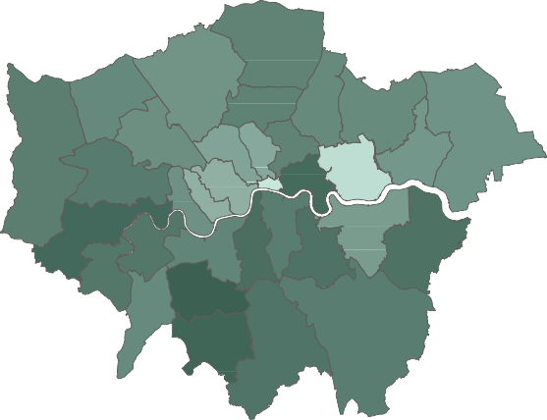
Rate of statements or EHC, and by Age
21/11/2019 Page 1
1/1
Select LA
Multiple selections 
Rate of Children and young people with statements or EHC plans at census date each year (per 10k)
ENGLAND INNER LONDON LONDON OUTER LONDON
220
Rate of Children and young people with statements or EHC plans (per 10k) latest year
INNER LONDON
190.31
200
ENGLAND
202.36
180
160
LONDON
205.05
140
120
OUTER LONDON
214.79
2015
2016
2017
Date
2018
2019
Rate of Statement or EHC plan 2019 by Thematic map
Rate of Children and young people with a statement or EHC plan by age
Under 5 Aged 5-10 Aged 11-15 Aged 16 to 19 Aged 20-25
ENGLAND
INNER LONDON
LONDON
OUTER LONDON
Min
56
Max
267
0%
20%
40%
60%
80%
100%

Slide 4
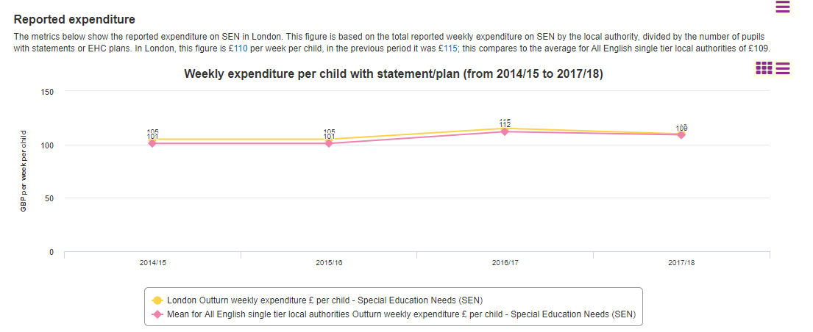
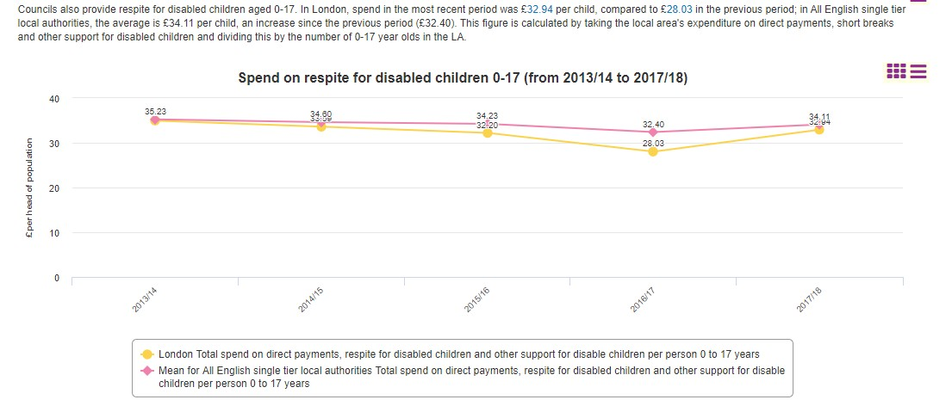
6.Finance and Funding data
21/11/2019 Page 7
1/1
London versus England Funding comparisons -
More information on this data is available at the LG inform website.
Respite care
Outturn weekly expenditure £ per child - Special Education Needs (SEN) latest year
500
400
300
200
100
0
Newham
Croydon
Brent
Haringey
Sutton
Bromley
Ealing
Hackney
LONDON
Barnet
Camden
ENGLAND
Merton
Islington
Bexley
Harrow
Havering
Lambeth
Lewisham
Enfield
Hounslow
Redbridge
Westminster
Greenwich
Southwark
Hillingdon
City of London
Wandsworth
Richmond upon Tha…
Tower Hamlets
Hammersmith and F…
Waltham Forest
Kensington and Chel…
Kingston upon Tham…
Barking and Dagenh…
Includes the Section 251 budget lines: SEN support services, Direct Payments (SEN and disability); SEN Transport, Home to school transport (pre-16): SEN transport expenditure, SEN Admin, assessment and coordination and monitoring

Slide 5
National Developments
DFE Led review with 3 external advisors
Scope includes – perverse incentives, responsibility and absence of accountabilities
Approach ‘Act’ intention versus evidence of what is happening
Review to conclude in Easter
Recommendations regarding money, process and leadership – Council Leads, CEOs, CCG, Headteachers
Key Message – without improving leadership it will fail

Slide 6
What is the point of Regional Improvement?
Agree together what good looks like, anchored in the lived experience, hopes and dreams for children and their parents and carers
The implication of “looking good” for our practice, commissioning and impact
Building relationships with each other and the wider sector to provide a stronger, more joined up network of support for children and families bound by common values and principles - children, parents, schools, VCS, health and private providers
Use our collective experience and innovation to learn from and challenge each other to be the best we can be for children and families

Slide 7
SEND RI
SEND Finance Group (executive)
London’s Parent Carers Forum
DFE & Tribunals Pathfinder
STP / Health
AD Commissioners Group
School Transport Leads
ADCS Workforce
SEND Regional Group (DFE Pathfinder)
Young People’s Skills Board
Head of School Improvement Group
DCO/DCM Group
National Send Review

Slide 8
Working Together; London’s Children, Young People, Families and Partners
Are committed to the ambitions of the Children and Family Act and SEND reforms
Want all children and young people with SEND to thrive in their families, local schools and communities
Will work in partnership with children, young people, parents, carers and each other to improve outcomes and enable independence for successful adulthood
Do all we can to ensure schools and further and higher education providers are inclusive and that parents and carers are able to exercise parental choice in the best interests of their children
Shape local care, support, and free time provider markets to empower children, young people and families to flourish in their communities

