Slide 1
LONDON ADOLESCENT SAFEGUARDING OVERSIGHT BOARD - a sub group of the LSCP
Florence Kroll, Director of Children’s Services RB Greenwich
ALDCS Adolescent Safeguarding Lead
The LSCP Executive has established the London Adolescent Safeguarding Oversight Board (LASOB) to coordinate and draw together the range of partner activity in this sphere. The LSCP executive is updated on LASOB’s work on a six-monthly basis (at minimum).
LASOB’s work can overlap with other governance bodies (such as the London Crime Reduction Board and Mayor’s Partnership Reference Group) and links to these structures and recognition of the relationship between violence, exploitation and the safety of adolescents will clearly be important in the LASOB remit.

Slide 2
ALDCS Adolescent Safeguarding – A priority for London
Adolescent Safeguarding includes the range of individual, familial and community risks and safeguarding concerns that children experience in terms of risks to themselves, risk from others and risks to others.
It is a complex dynamic that requires a system wide focus that includes disproportionality and discrimination all of which necessitate multi-layered and systemic solutions.
There is an abundance of activity across London to enhance adolescent safeguarding and some common themes and approaches.
We want to promote integrated child and family methods that focus on experience, rather than multiple different responses driven by services
Activity in this realm can be poorly coordinated and risks dissipating the energy and resources which are being applied

Slide 3
LASOB
PURPOSE and FOCUS
The board’s particular focus will be on work which has a multi-borough or pan-London focus.
provide coordination and oversight to the range of partner initiatives and where possible draw this into a shared programme of sequenced activity.
learn from effective local LSCP and violence and vulnerability work but not duplicate local activity and governance.
identify and promote effective practice in safeguarding adolescents and reducing disproportionality.
Within this scope also comes support for work to promote a consistent safeguarding response to adolescent extra-familial harm. We know legislation, statutory guidance and child protection procedures are poorly framed to respond to adolescent risk outside of the home and as a result a variety of approaches and thresholds are applied. Partners, particularly the police, find LA’s diverse responses hard to navigate in their work between boroughs. The LASOB work plan will address these issues with the overall aim to improve outcomes for young people.

Slide 4
LASOB ACTIVITY
Current activity within the LASOB work programme include:
Implementation of the London Child Exploitation protocol including the MACE review and improvement project
Embedding the multi-agency Adolescent Safeguarding Practice Handbook
Oversight of the Pan London “Your Choice” programme including the Youth Endowment Fund RCT evaluation
Oversight of the Reducing Criminalisation of Children in Care protocol
Review of the LSCP child protection procedures in relation to extra-familial harm.
Activity in relation to child criminal exploitation that stems from the LCRB and MOPAC disproportionality work
Support for the developing complex adolescent placement workstream which sits within the Pan-London Placement Commissioning Programme.
Serious youth violence
Bullying and social isolation
Radicalisation
Teenage relationship abuse
Criminal exploitation
Sexual exploitation

Slide 5
LASOB vision and workstream proposal
Our collective vision is to safeguard adolescents, reduce risk and achieve the best outcomes for vulnerable adolescents in London. We need to develop how we will do this, what our aspiration is and what activity might be effective
We propose that as a starting point we frame the LASOB work plan around the three domains which create or contribute to increased vulnerability and risk in adolescence as described by Keith Ibbetson through his analysis of serious case reviews over the last five years.
Individual and Family Factors
Contextual Factors
System Effect

Slide 6
LASOB
PURPOSE and FOCUS
The board’s particular focus will be on work which has a multi-borough or pan-London focus.
provide coordination (Coordinate) and oversight to the range of partner initiatives and where possible draw this into a shared programme of sequenced activity.
learn (communicate)from effective local LSCP and violence and vulnerability work but not duplicate (challenge) local activity and governance.
identify and promote (collaborate and develop)effective practice in safeguarding adolescents.

Slide 7
LASOB: 21.05.21 Learning from review of death and injury linked to serious youth violence
Individual & Family
Contextual
Keith Ibbetson presentation - Factors creating vulnerability and risk for children and young people
System Effect
Notes:
System factors

Slide 8
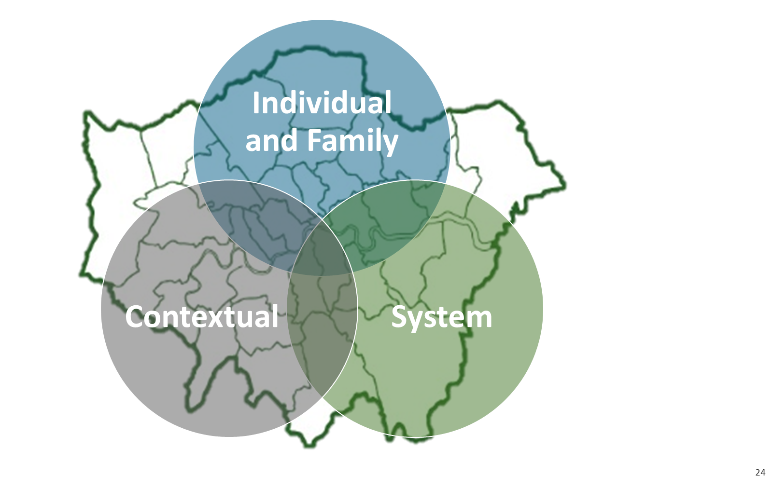
LASOB VISION, THREE Domains, 4C+d and WAYS OF WORKING
This slide creates a visual for the LASOB vision, the three domains and a easy 4C+D way of framing our collective focus and purpose.
The four blocks at the bottom identify potential ways for LASOB to undertake work and engage with activity and oversight.
Challenge - Coordinate – Communicate – Collaborate – Develop
LASOB Community of Practice and Youth Voice
LASOB Oversight
Expert Groups
LASOB Working Groups

Slide 9
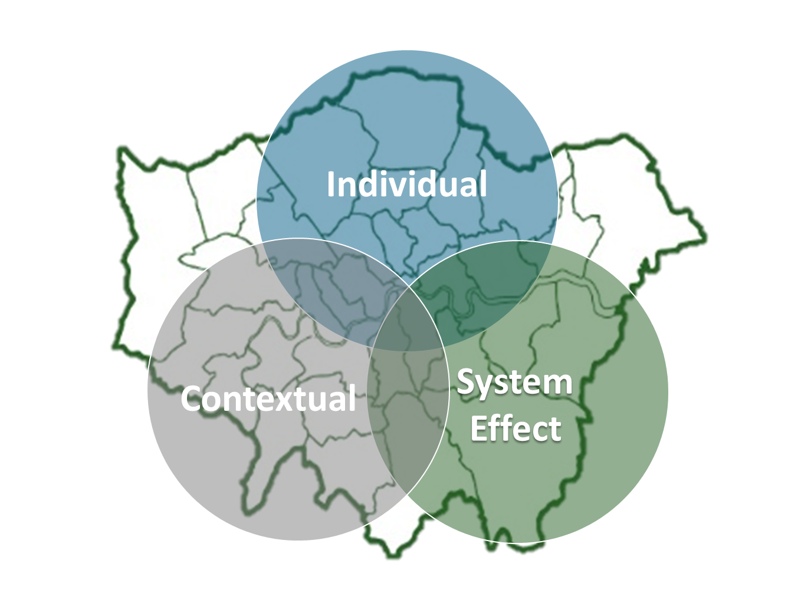
Lasob: developing a working model activity and decision making principles
The responsibility for safeguarding and service delivery remains with the local CSP. Recommendations made by LASOB will be owned at that local level.
Any activity that is undertaken will meet a set of questions;- does the issue require a Pan London response or coordination, how does it add value, does it provide tools, mechanisms or resources that contribute to system improvements?
Is there evidence or emerging evidence that the initiative will contribute to achieving better outcomes including tackling disproportionality for vulnerable adolescents in London?
Does the activity or decision promote integrated child and family methods that focus on experience, rather than multiple different responses driven by services?
Does the proposed activity meet the three domains and the 4C+D ways of working? What data or qualitive evidence is required to inform required activity or decision?

Slide 10
WORKSTREAMS AND WAYS OF WORKING
LASOB Community of Practice
LASOB Oversight
Expert Groups
LASOB Working Groups
Peer Network of interested professionals and Youth Voice
Emerging from the TCE input a Peer Network emerged of professionals interested in advising LASOB to think differently about how we work together and break the mould of traditional multi-agency working patterns and behaviours.
A focus on the voice and influence of young people is also improtnast and we will utilise existing groups to inform youth engagement.
Engagement with LASOB members at meetings and across the partnership
LASOB model some of the behaviours and join-up we want to see and provide the 4Cs + D across London adolescent safeguarding initiatives and policy. Recommendations are made to organisations, ALDCS or the London Safeguarding Children Partnership.
Engagement and Development by expert groups
If a workstream requires expertise LASOB will look to the membership to consider commissioning work to experts in the field. For example the Social Care practice leaders are engaging with wider group of Practice leaders to develop the child protection guidelines for extra familial harm. Expert groups also include experts by experience such as young people, community groups and parents/carers.
Task and finish groups as identified
LASOB members may be involved in multi agency task and finish group or focus group for action or consideration of a particular topic for recommendations to the wider LASOB board members.

Slide 11
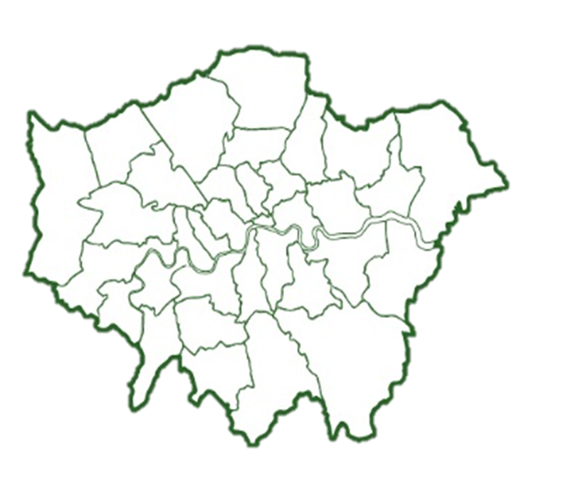
Lasob MEMBERSHIP – ACOUNTABLE TO lscp EXECUATIVE AND WILL REPORT INTO Aldcs and other key networks and governance structures
LA CHILDREN’S SERVICES
POLICE
Safeguarding Commander – Kevin Southworth
Exploitation – Andy Furphy
Child protection – Iain Keating
Missing – TBC
MACE – Andrew Grant
DCS - Florence Kroll Greenwich, Pinaki Ghoshal – Lewisham, Jane Mc Sherry - Merton
ADs - Daniel Phelps – Waltham Forest, Valentin Danciu – Hillingdon, Róisín Madden - Croydon
LA - COMMUNITY SAFETY AND HOUSING
Stephanie Royston-Mitchell - Community Safety – Kingston
Darren Welsch - Director Housing - Waltham Forest
VIOLENCE REDUCTION UNIT and MOPAC
Sharon White (VRU)
Geeta Subramanium – Mooney (VRU)
Will Balakrishnan (MOPAC)
VCS and INDEPENDENT
Pippa Goodfellow – Alliance for Youth Justice
Chris Miller – Independent Safeguarding Chair
Luke Bellingham – Hackney Quest
Sherrylyn Peck – Safer London
HEALTH
NHS and Justice – Sinead Dervin / Perpetua Kamwendo
CCG (Chief Nurse)
Public Health –
EDUCATION
Sir John Coles - CEO United Learning Trust
Sir Dan Moynihan - CEO Harris Academy
Further education college - TBC
YJB, YOT NETWORK AND PROBATION
Henry Smithers (YJB)
Probation – Kate Nash
LONDON COUNCILS AND LIIA
Ben Byrne – LIIA Strategic Lead
Jeanne King – LASOB development
LASOB PEER NETWORK
Jennifer Williams
.

